Slide 1
2014 Aircraft – Flight Test 1
Propulsion Debrief
Date: 2014-11-25
Flight Date: 2014-11-22

Slide 2
Misc. Lessons Learned
Problem Encountered | Solution
Batteries can not charge to full in cold | Bring space heater for batteries
Batteries must be stored warm | Store in car
Poor wiring on safety plug | Bypass
Poor setup in electronics bay | Consider adding different battery loading design for 2015 plane
Too much wire length for servos | Shorten for 2015 plane

Slide 3
FLIGHT DATA ANALYSIS

Slide 4
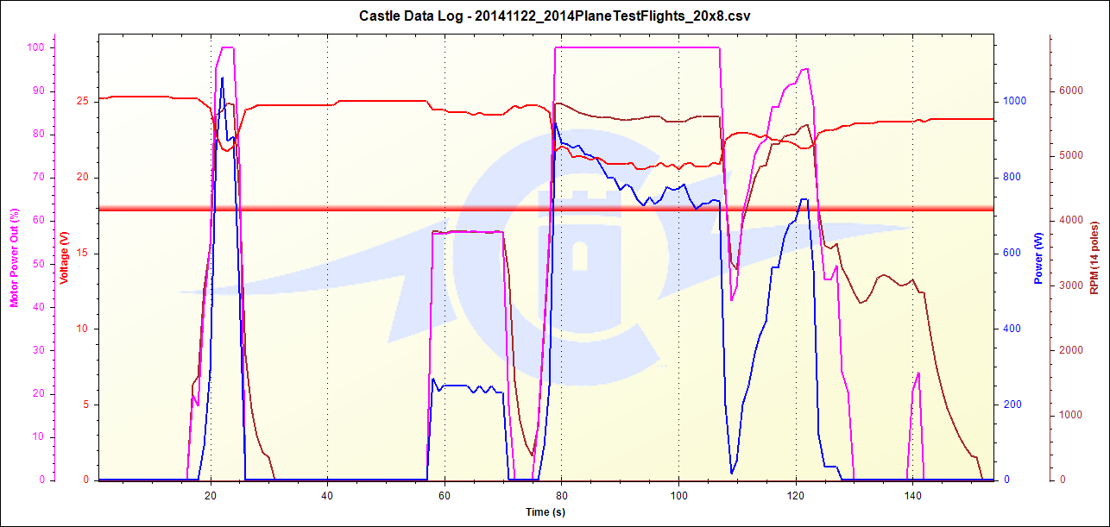
Typical Flight Cycle
Pre-runway
test
Full throttle in flight
Battery Warmup
Flight time

Slide 5
Flight Summaries
Flight | Prop | Takeoff Distance [ft] | Altitude [ft] | Temperature [F] | Density Altitude [ft] | Result
1 | 20x8 | 120 | 751 | 34 | -1061 | Broken vertical tail - fixed
2 | 20x8 | 158 | 751 | 42 | -465 | Perfect
3 | 19x10 | 150 | 751 | 44 | -287 | Destruction

Slide 6
Crash Summary
2014 Plane is unusable – good to take apart
ESC, Prop, Motor, Receiver and Receiver battery are fine
Motor battery damaged - OK for ground testing
  Will not fly again

Slide 7
Flight 1 Notes
20x8 prop
~10MPH crosswind @ 30deg to port from nose

Slide 8
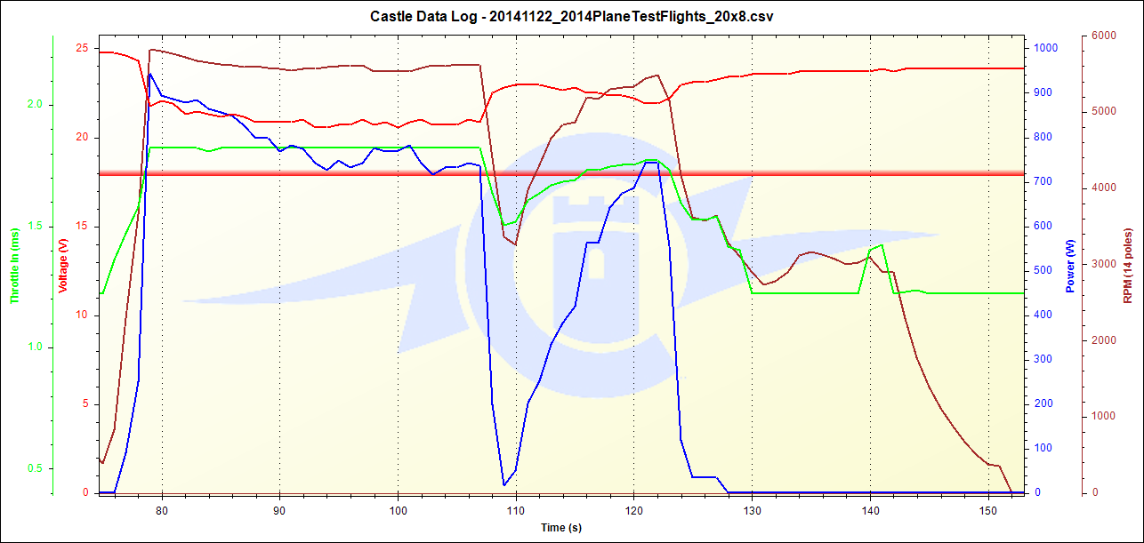
Flight 1
1000W
942W
ROLLING
TOUCH
58W Margin to limiter @ Full Throttle/static

Slide 9
Flight 1 Results
Payload: 22lbs
Takeoff Distance: 120 ft
  Could have been ~90ft
  Crosswind was partial headwind

Slide 10
Flight 1 Takeaways
Hinges must be put into solid wood surface to be held in, or reinforced with glue

Slide 11
Flight 2 Notes
20x8 prop
Much calmer wind
Bypassed shunt plug (should produce extra power margin)

Slide 12
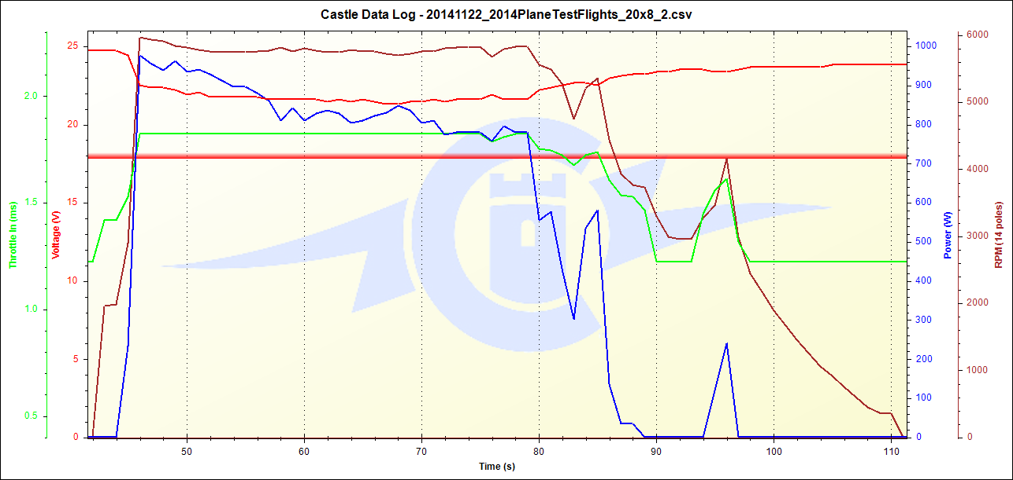
Flight 2
1000W
976W
ROLLING
TOUCH
24W Margin to limiter @ Full Throttle/static

Slide 13
Flight 2 Results
Payload: 22lbs
Takeoff Distance: 158 ft
  Much calmer wind – more reliable result

Slide 14
Flight 2 Takeaways
Need to test 20x8 prop in low wind, with all full length wiring (can be done on test stand)
  Quantify true power draw since close on margin

Slide 15
Flight 3 Notes
19x10 prop
Wind calm like Flight 2
Shunt bypassed like Flight 2

Slide 16
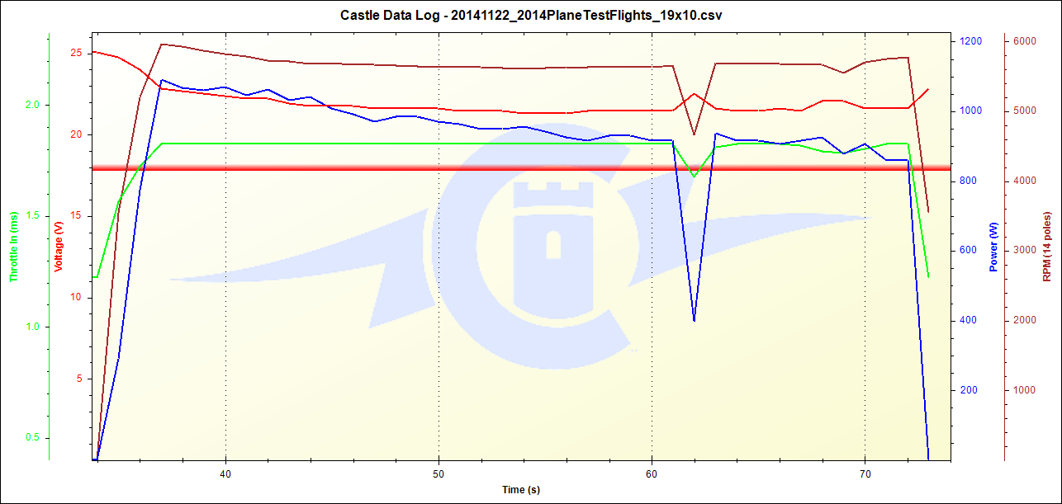
Flight 3
1000W
1092W
ROLLING
BREAKS
SPLAT
92W OVER limit @ Full Throttle/static

Slide 17
Flight 3 Results
Payload: 22lbs
Takeoff Distance: 150 ft
  Much calmer wind – more reliable result

Slide 18
Flight 3 Takeaways
19x10 prop has higher top speed – Santiago preferred
  Attempt to modify 19x10 props shorter to reduce power draw

Slide 19
Actions Out: Propulsion
Priority 1 – Necessary for first flight of 2015 plane
Action | Priority | Est. Date Complete
Aircraft length test stand | 1 | Dec 2
Verify wire gage needed | 1 | Complete: 10AWG
19x10 prop mod testing | 1 | Testing Complete
Test battery temperature affect on output | 1 | Dec 2
Investigate Capacitor Bank | 2 | Order if useful: Dec 4
Test with Kontronik Jive | 2 | ?? – When Santiago down for inspection

